Slide 1
Hint Game
Explain what it is but don’t say the word!

Slide 2

Kumamon

Slide 3

Motorbike

Slide 4

School

Slide 5

Library

Slide 6

Boat

Slide 7
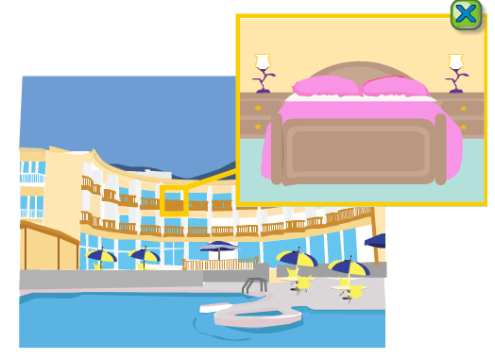
Hotel

Slide 8

Bee

Slide 9

Sad

Slide 10
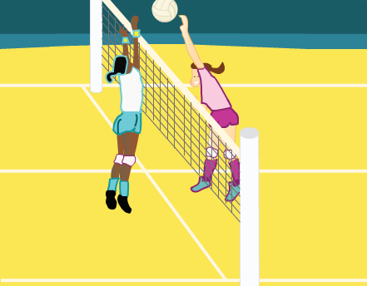
Volleyball

Slide 11
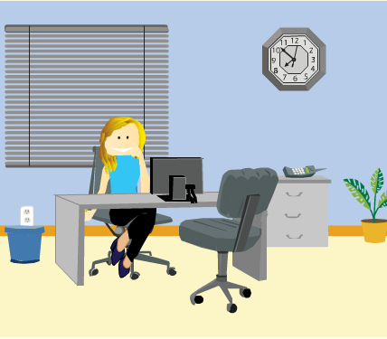
Office

Slide 12
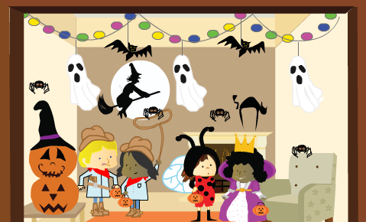
Halloween

Slide 13

Horse

Slide 14

Valentines Day

Slide 15

Watermelon

Slide 16

Train

Slide 17
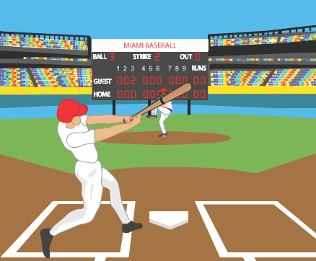
Baseball

Slide 18
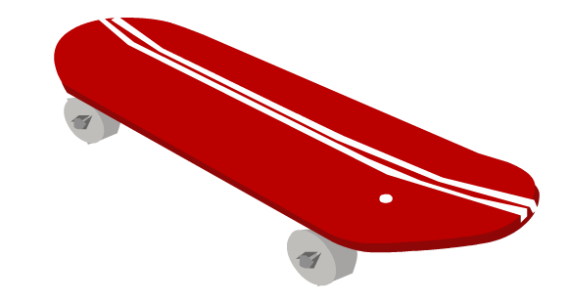
Skateboard

Slide 19

Ambulance

Slide 20

Tennis

Slide 21

Park

Slide 22

Ferry

Slide 23
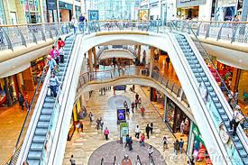
Mall

Slide 24
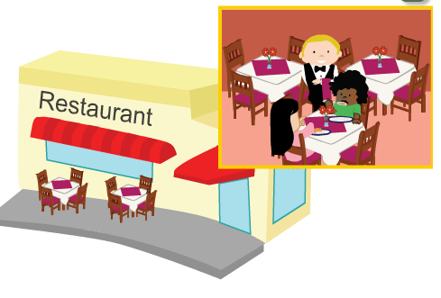
Restaurant

Slide 25
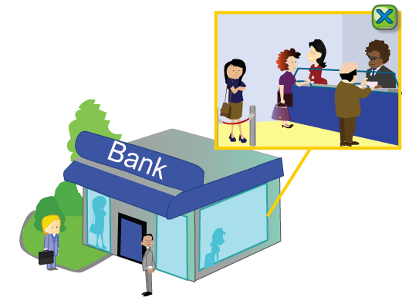
Bank

Slide 26

Cheese

Slide 27
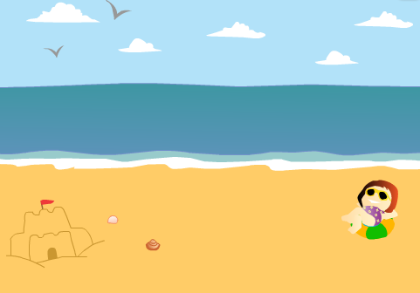
Beach

Slide 28
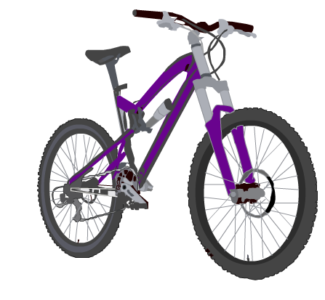
Bicycle

Slide 29

Superman

Slide 30
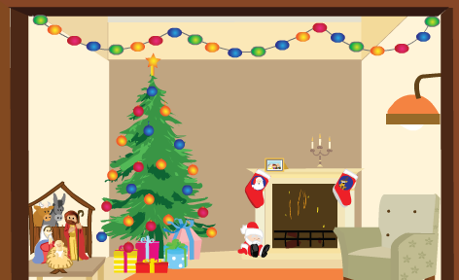
Christmas

Slide 31

Taxi

Slide 32
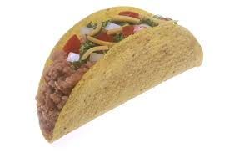
Taco

Slide 33

Fox

Slide 34

Happy

Slide 35

Bat

Slide 36
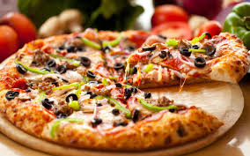
Pizza

Slide 37
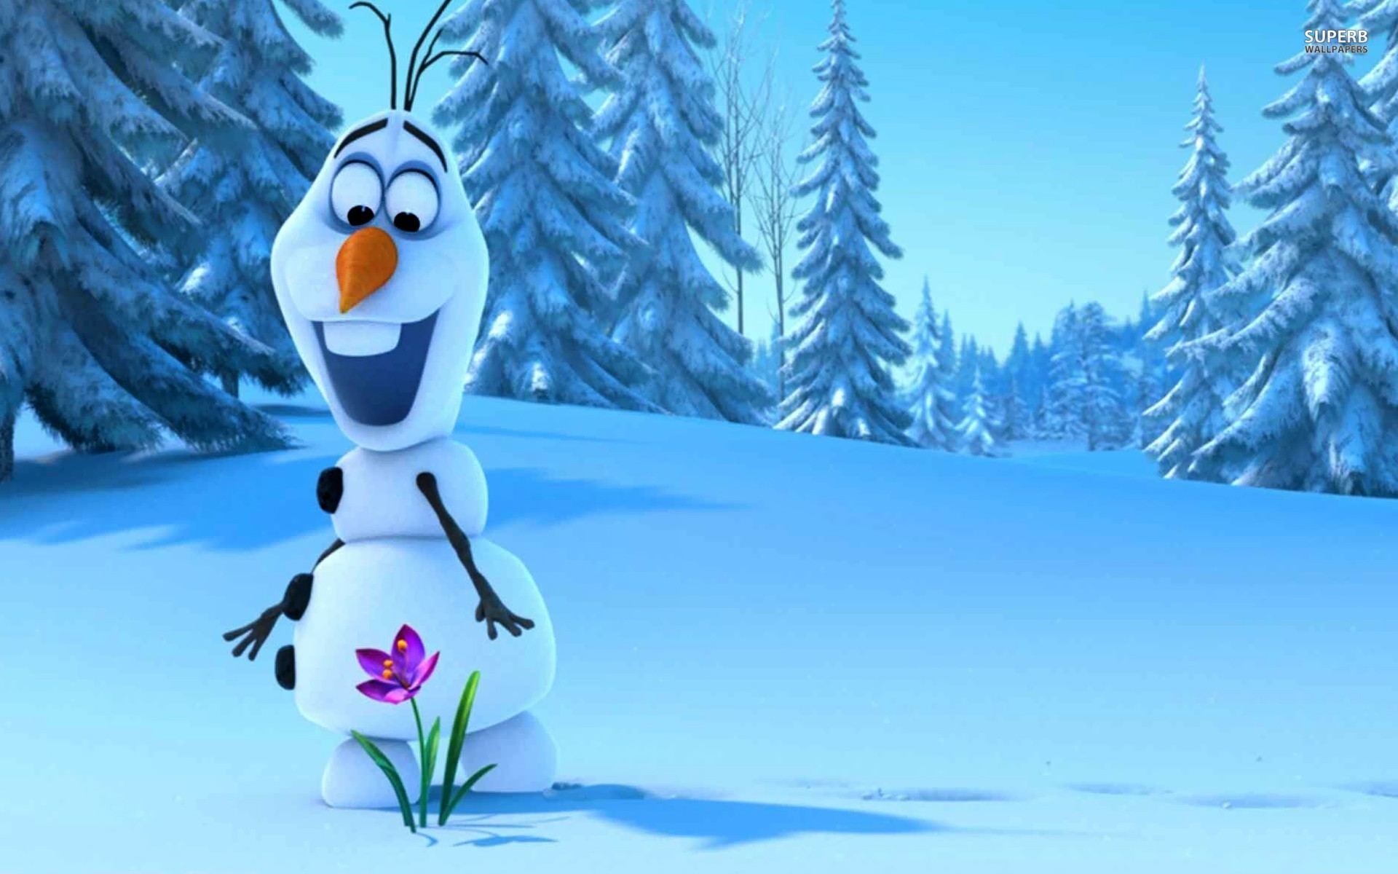
Olaf

Slide 38
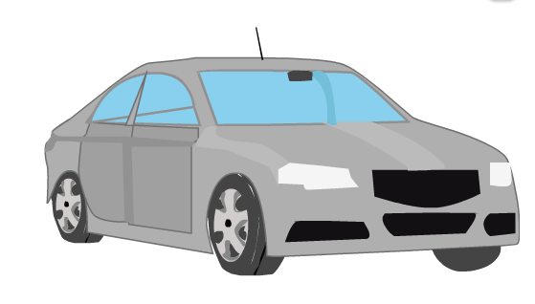
Car

Slide 39

Soccer (Football)

Slide 40

Spider

Slide 41

Milk

Slide 42

Snow

Slide 43
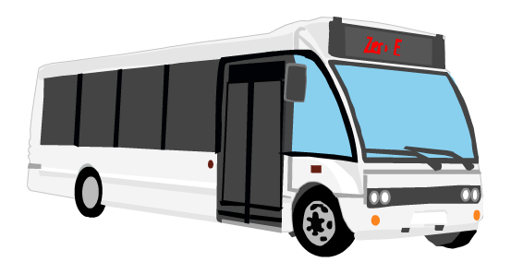
Bus

Slide 44

Pineapple

Slide 45

Computer

Slide 46

Ojipan

Slide 47
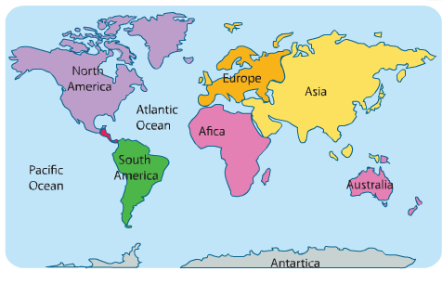
Map

Slide 48

Submarine

Slide 49

Mosquito

Slide 50

Hikonyan

Slide 51

Strawberry

Slide 52

Tea

Slide 53
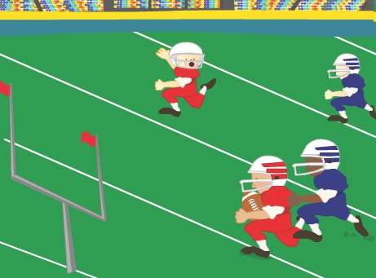
American Football

Slide 54
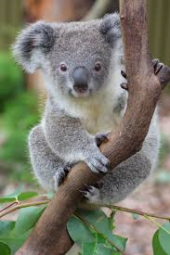
Koala

Slide 55

Hospital

Slide 56

Calendar

Slide 57
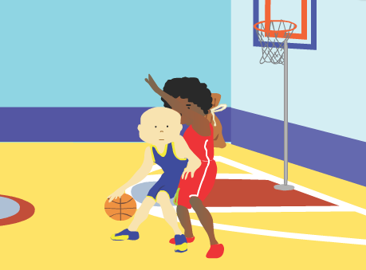
Basketball

Slide 58
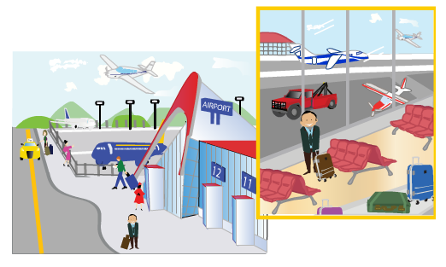
Airport

Slide 59

Jibanyan

Slide 60
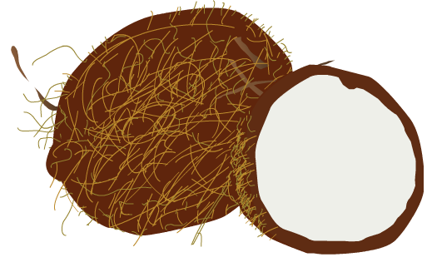
Coconut

Slide 61
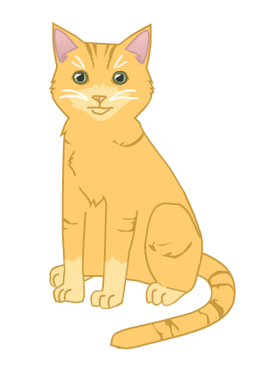
Cat

Slide 62
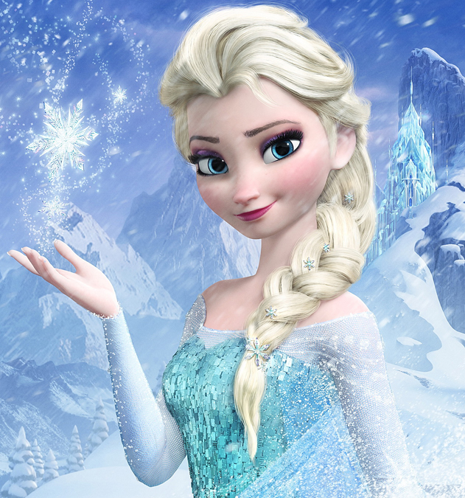
Elsa

Slide 63
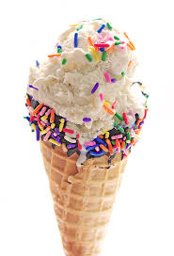
Ice Cream

Slide 64

Mario

Slide 65
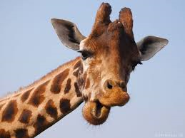
Giraffe

Slide 66
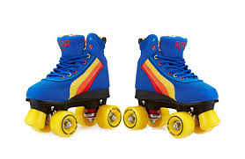
Roller Skates

Slide 67
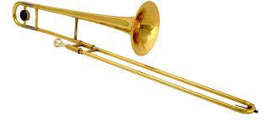
Trombone

Slide 68

Desk

Slide 69
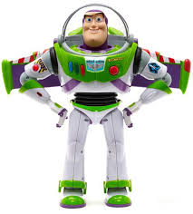
Buzz Lightyear

Slide 70
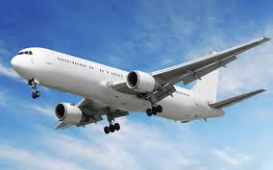
Airplane

Slide 71
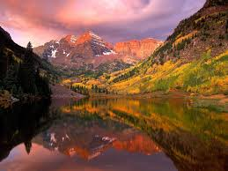
Mountain

Slide 72

Fishing

Slide 73

America

Slide 74

Coffee

Slide 75
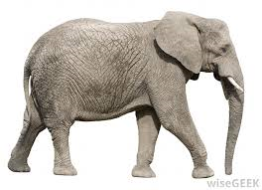
Elephant

Slide 76
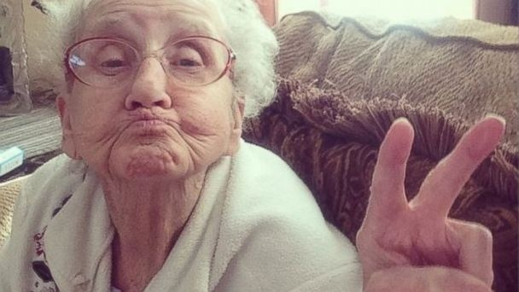
Grandmother

Slide 77
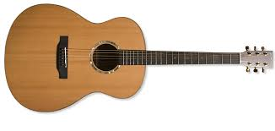
Guitar

Slide 78
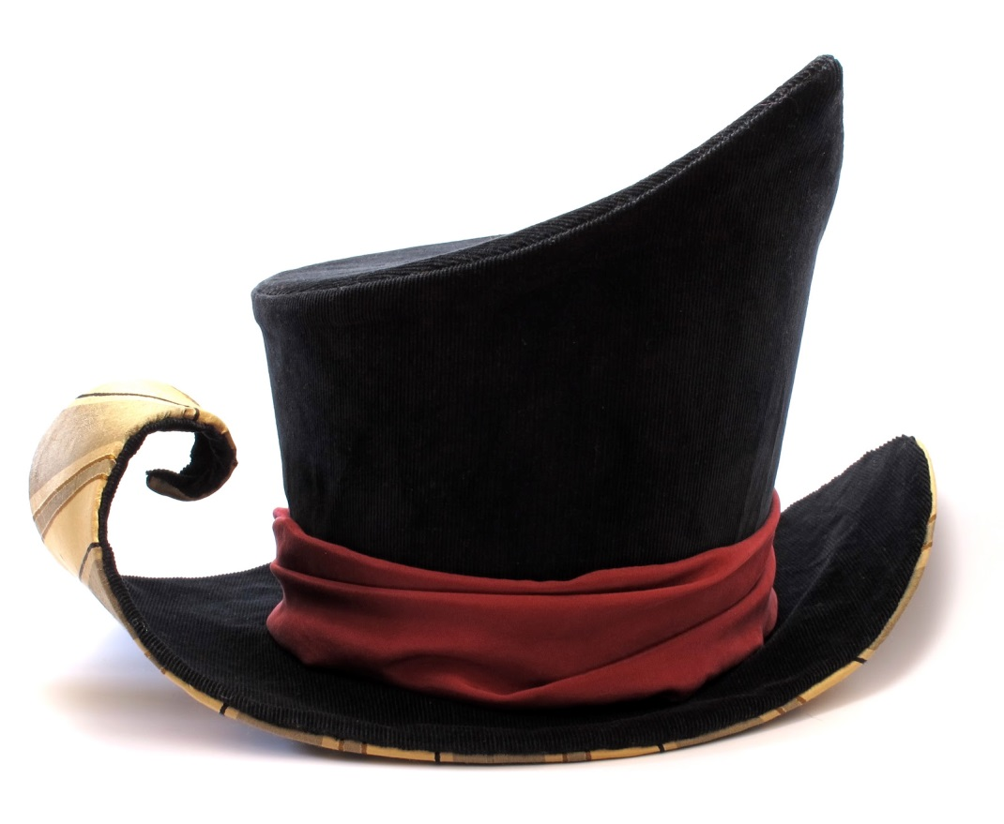
Hat

Slide 79
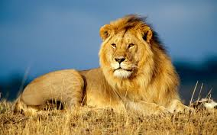
Lion

Slide 80

Rain

Slide 81

Reindeer

Slide 82

Rocket

Slide 83
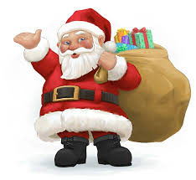
Santa Claus

Slide 84
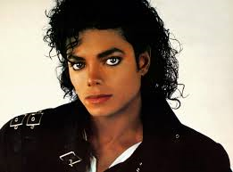
Michael Jackson

Slide 85
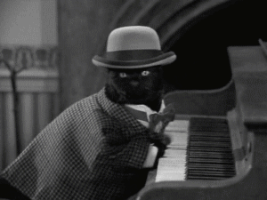
Piano Cat

Slide 86
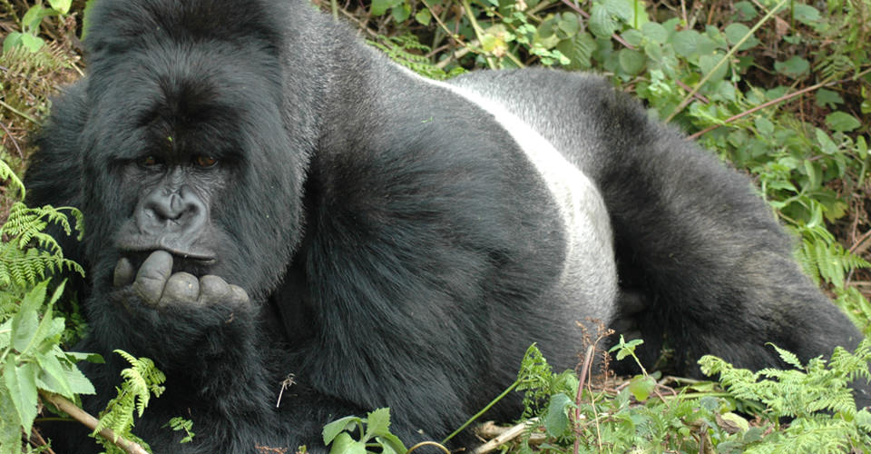
Gorilla

Slide 87
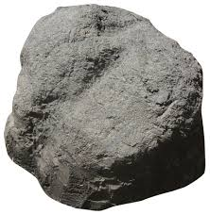
Rock

Slide 88
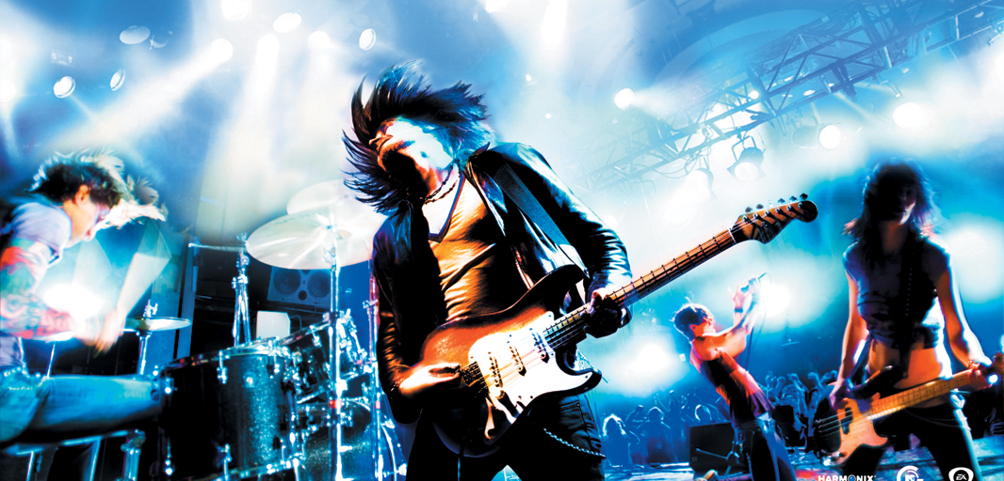
Rock

Slide 89

Sun

Slide 90

Australia

Slide 91
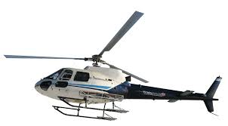
Helicopter

Slide 92

High Five

Slide 93

Cookie Monster

Slide 94
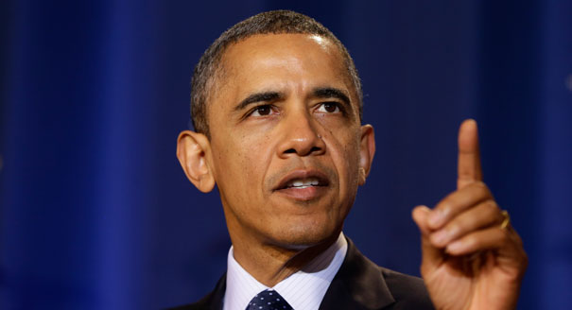
Barack Obama

Slide 95
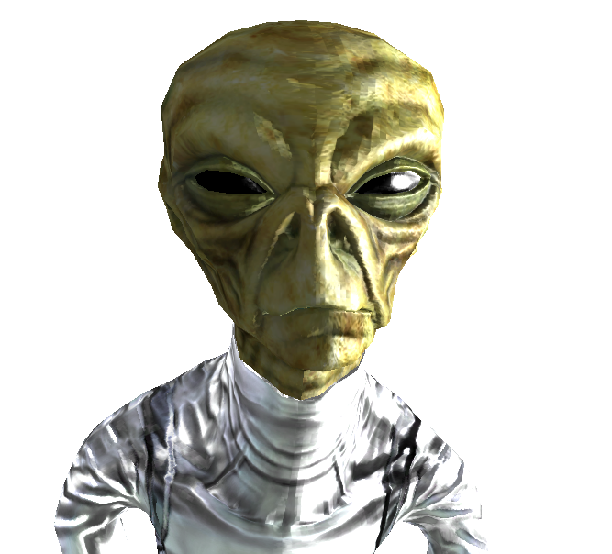
Alien

Slide 96
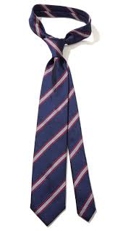
Necktie

Slide 97

Present

Slide 98

Green

Slide 99
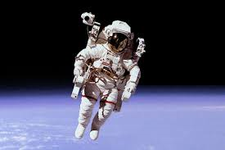
Astronaut

Slide 100
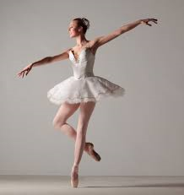
Ballet

Slide 101
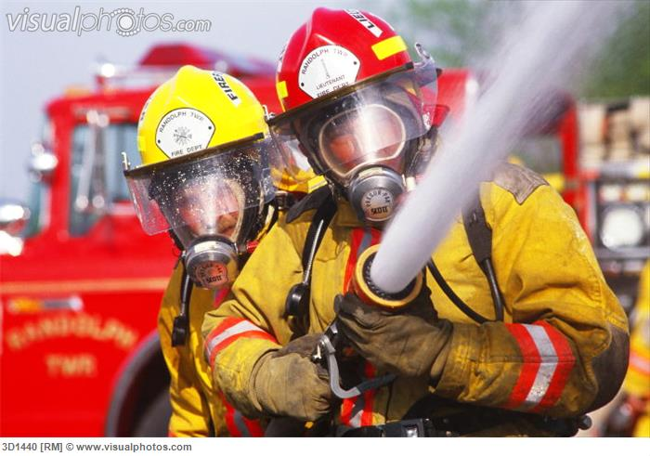
Fire Fighter

Slide 102

Frog

Slide 103

Jump Rope

Slide 104

Nose

Slide 105

Pencil

Slide 106

Snowboard

Slide 107

Sumo

Slide 108

Telephone

